Slide 1


HEALTHWIKI
HEALTHWIKI
Presented by
-Harsh Mishra
-Harsh Tomar
-Honey Chaudhary
-Hritik Sharma

Slide 2


Health Wiki
A tech-powered platform promoting health awareness by providing user-friendly insights into specific body pain, facilitating informed decisions and positive changes for a healthier society.

Slide 3

INDEX
INTRODUCTION
PROBLEM STATEMENT
MOTIVATION
LITERATURE SURVEY
TECHNOLOGY USED
RESULT
FUTURE SCOPE
ACKNOWLEDGEMENT

Slide 4
INDEX
INTRODUCTION
PROBLEM STATEMENT
MOTIVATION
LITERATURE SURVEY
TECHNOLOGY USED
RESULT
FUTURE SCOPE
ACKNOWLEDGEMENT

Slide 5

INDEX
INTRODUCTION
PROBLEM STATEMENT
MOTIVATION
LITERATURE SURVEY
TECHNOLOGY USED
RESULT
FUTURE SCOPE
ACKNOWLEDGEMENT

Slide 6
INDEX
INTRODUCTION
PROBLEM STATEMENT
MOTIVATION
LITERATURE SURVEY
TECHNOLOGY USED
RESULT
FUTURE SCOPE
ACKNOWLEDGEMENT

Slide 7
INTRODUCTION
1
Project goal: Create an interactive digital representation of the human body.
Users can click on body parts to reveal potential internal health issues.

Slide 8
INTRODUCTION
1
2
Project goal: Create an interactive digital representation of the human body.
Users can click on body parts to reveal potential internal health issues.
Merges technology with medical insights for engaging education.
Digital body structure facilitates user exploration of anatomical regions.

Slide 9
INTRODUCTION
1
2
3
Merges technology with medical insights for engaging education.
Digital body structure facilitates user exploration of anatomical regions.
Highlights potential health issues without visible symptoms.
Utilizes technology to impart medical knowledge in an engaging manner.
Encourages users to understand and manage internal health concerns effectively.
Project goal: Create an interactive digital representation of the human body.
Users can click on body parts to reveal potential internal health issues.

Slide 10
PROBLEM STATEMENT
The absence of easily accessible, user-friendly platforms impedes individuals from gaining insights into localized body pain, hindering their ability to understand and potentially address underlying health concerns. This project aims to fill this gap by creating an interactive website featuring a human body model. Users can interact with this model, selecting specific body parts to gain information about associated pain, facilitating preliminary self-diagnosis and guiding users toward appropriate healthcare measures.

Slide 11
Barrier to Insight
Interactive Anatomy
Empowerment Platform
“The absence of user-friendly platforms limits understanding and addressing localized body pain.”
“This project aims to fill this gap by creating an interactive website featuring a human body model.”
“Users interact, select body parts for pain info, enabling self-diagnosis and healthcare guidance.”

Slide 12
PROBLEM STATEMENT
Interactive Anatomy
Barrier to Insight
“This project aims to fill this gap by creating an interactive website featuring a human body model.”
“The absence of user-friendly platforms limits understanding and addressing localized body pain.”
Empowerment Platform
“Users interact, select body parts for pain info, enabling self-diagnosis and healthcare guidance.”

Slide 13



M O
T
I
V
A
T
I
O
N
Enabling Awareness
Impactful Change
HEALTHWIKI
Promoting health awareness by empowering users to understand and manage specific body pain.
HEALTHWIKI bridges the knowledge gap, providing visual insights into body pain for informed health decisions, fostering user understanding and agency.
Tech-driven health insights for informed decisions Easily understand discomfort and positive changes. Join us for a healthier, informed society.

Slide 14
LITERATURE SURVEY
BACKGROUND
Explored existing health platforms online.
Identified the need for accessible health information.
RELATED WORK
Reviewed interactive anatomy apps and health websites.
Examined visualization techniques in medical information.
USER NEEDS
Investigated user preferences in online health information.
Explored demand for user-friendly health platforms.
TECHNOLOGICAL SOLUTIONS
Explored 3D modeling and interactive interfaces in similar applications.
Considered emerging technologies in health data visualization.
GAPS IN EXISTING SOLUTIONS
Identified limitations in current platforms, emphasizing user interaction and accessibility.
Highlighted the need for a visually informative and user-friendly health platform.
GAPS IN EXISTING SOLUTIONS
Found inspiration in studies and platforms that addressed identified gaps.
Guided the development of HEALTHWIKI based on literature survey insights.
Our literature survey forms the foundation for HEALTHWIKI ensuring it meets user needs and addresses gaps in existing health platforms.

Slide 15
LITERATURE SURVEY
Explored existing health platforms online and identified the need for accessible health information.
BACKGROUND
4
Reviewed interactive anatomy apps and health websites, examining visualization techniques.
RELATED WORK
5
Investigated user preferences in online health information and explored the demand for user-friendly platforms.
USER NEEDS
6

Slide 16



LITERATURE SURVEY
BACKGROUND
Explored existing health platforms online and identified the need for accessible health information.
RELATED WORK
Reviewed interactive anatomy apps and health websites, examining visualization techniques.
USER NEEDS
Investigated user preferences in online health information and explored the demand for user-friendly platforms.

Slide 17



TECHNOLOGICAL SOLUTIONS
Explored 3D modeling and interactive interfaces in similar applications, and considered emerging technologies.
GAPS IN EXISTING SOLUTIONS
Identified limitations in current platforms related to user interaction and accessibility.
INSIPIRATION FOR HEALTHWIKI
Found inspiration in studies and platforms that addressed identified gaps, guiding the project's development.

Slide 18
LITERATURE SURVEY
1
Explored existing health platforms online and identified the need for accessible health information.
4
Explored 3D modeling and interactive interfaces in similar applications, and considered emerging technologies.
2
Reviewed interactive anatomy apps and health websites, examining visualization techniques.
5
Identified limitations in current platforms related to user interaction and accessibility.
3
Investigated user preferences in online health information and explored the demand for user-friendly platforms.
6
Found inspiration in studies and platforms that addressed identified gaps, guiding the project's development.

Slide 19
TECHNOLOGY USED
1
Frontend
HTML5, CSS3,TAILWIND
Standard web technologies for structure, style, and interactivity.
2
Backend
Python Django:Python web framework for fast, DRY, and secure development.
SQL-LITE: NoSQL database for efficient data storage.
3
UI/Design
Bootstrap: Responsive front-end framework.
Figma: Design tool for wireframes and prototypes.
4
Version Control
Git, GitHub: Version control and collaborative development.

Slide 20
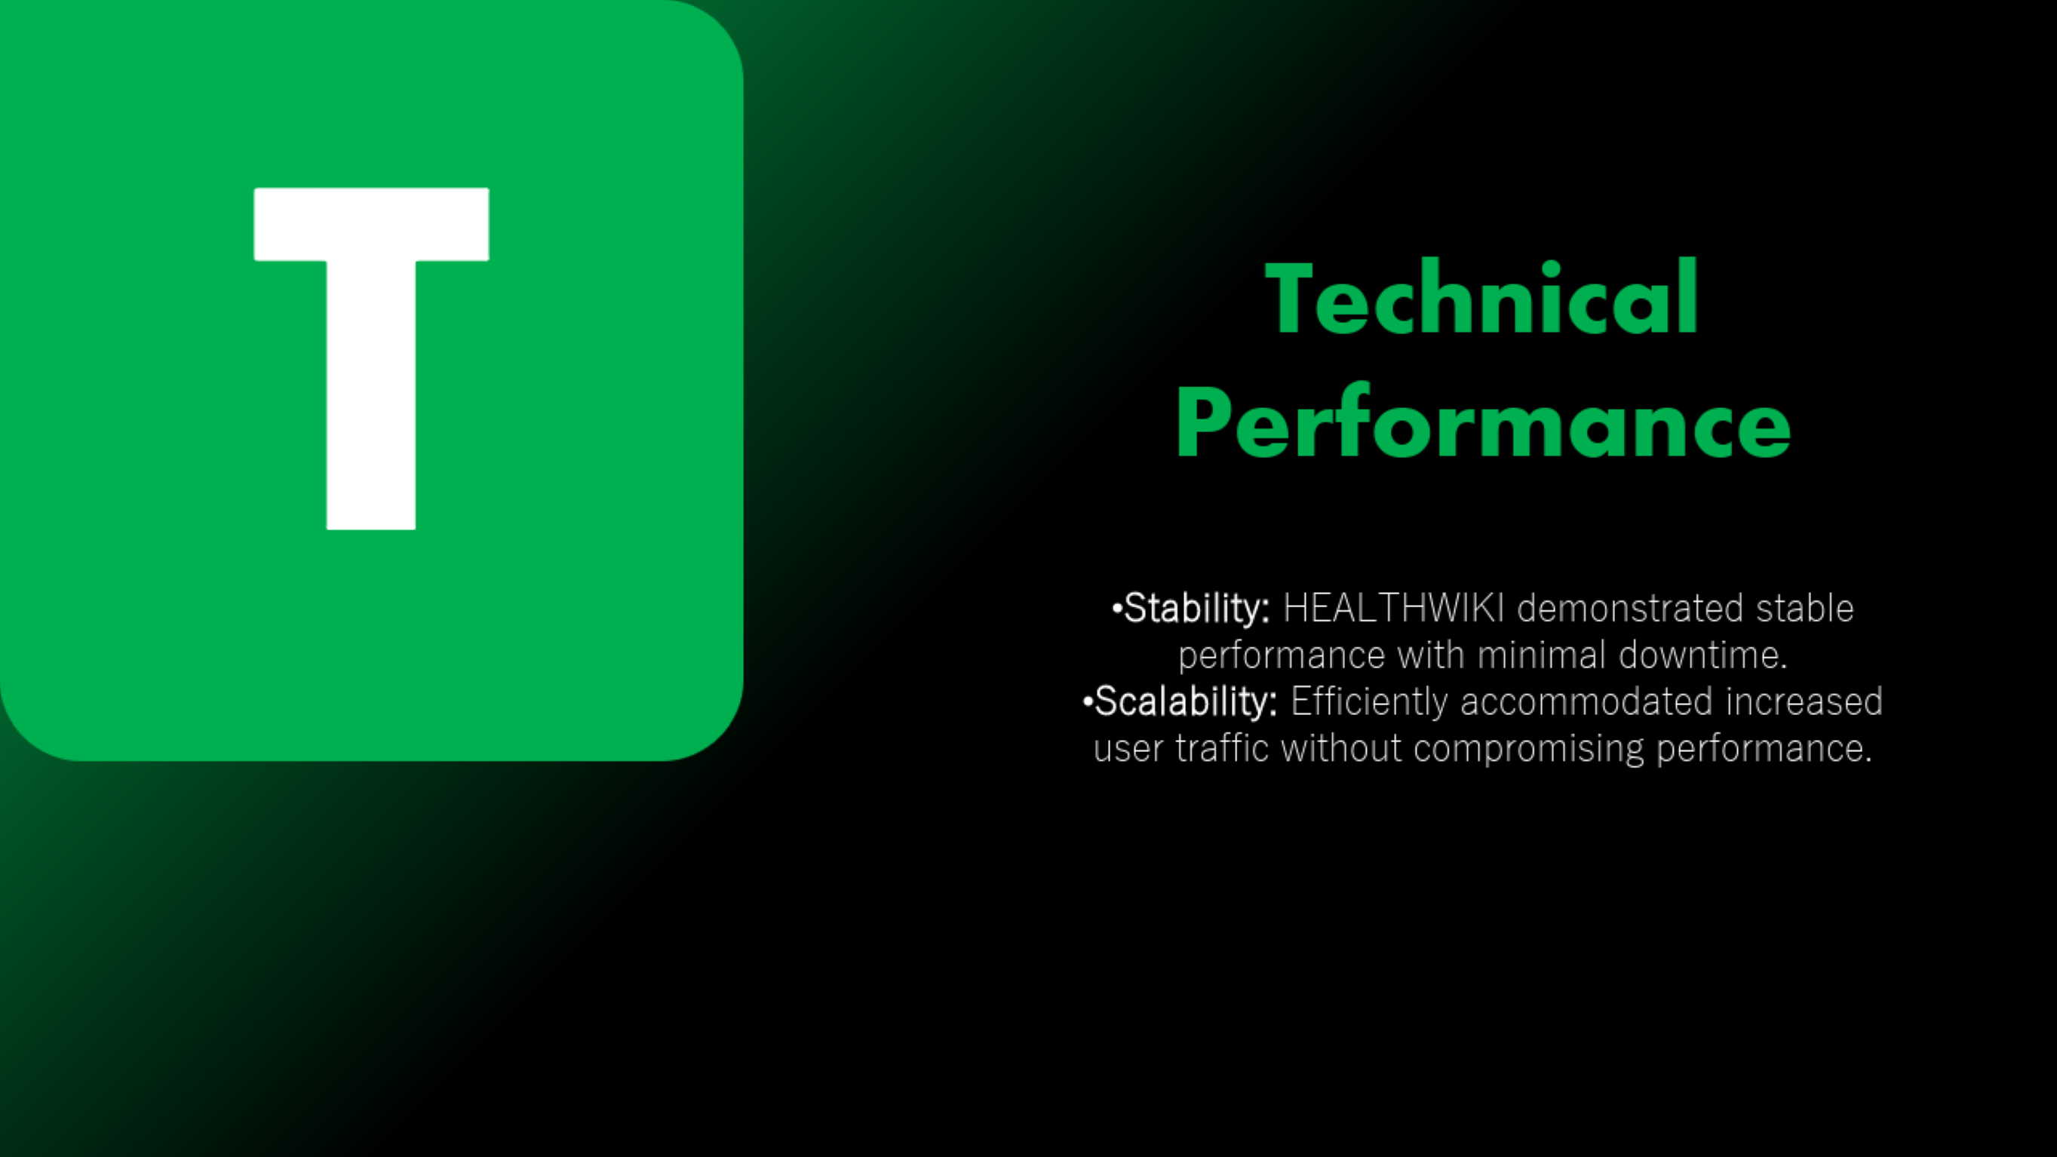
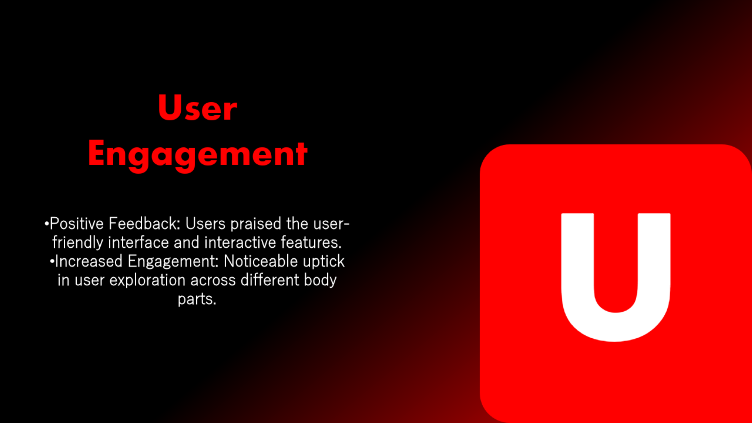
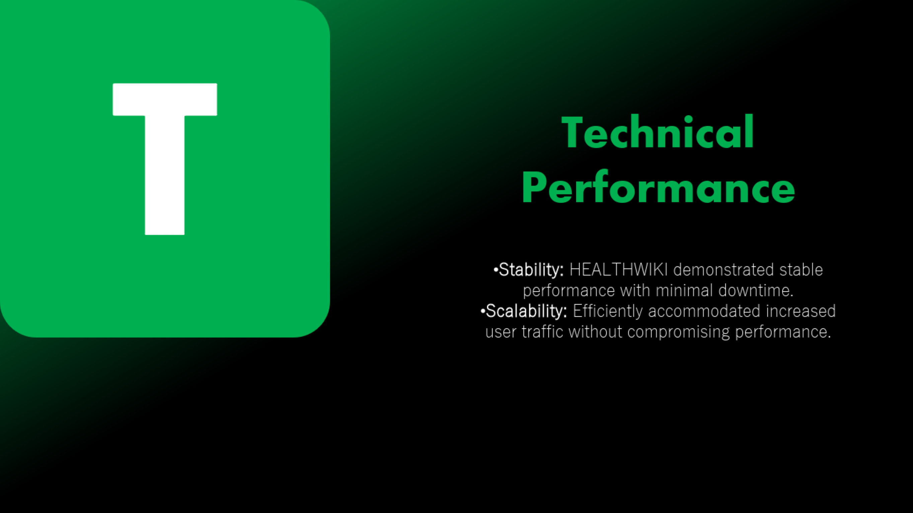


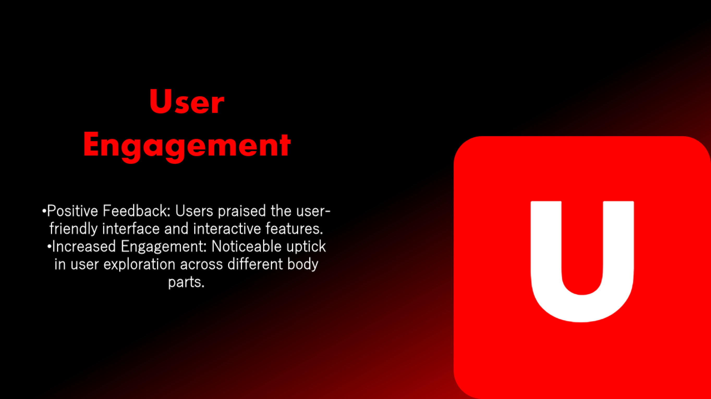
RESULTS

Slide 21
User Engagement
U
Positive Feedback: Users praised the user-friendly interface and interactive features.
Increased Engagement: Noticeable uptick in user exploration across different body parts.

Slide 22
Health Impact Awareness
H
Informed Decisions: Users reported making more informed health decisions using HEALTHWIKI.
Empowered Users: The platform empowered users with knowledge about pain-related issues.

Slide 23
T
Technical Performance
Stability: HEALTHWIKI demonstrated stable performance with minimal downtime.
Scalability: Efficiently accommodated increased user traffic without compromising performance.

Slide 24
C
Conclusion
Results highlight the success of HEALTHWIKI as a valuable health awareness resource.
Ongoing positive engagement and user feedback emphasize the project's impact in addressing the identified need.

Slide 25
FUTURE SCOPE
Enhancements
More Body Information: Expand the database for detailed body part information.
Pain Management Tips: Integrate tips for managing pain associated with specific body areas.

Slide 26
FUTURE SCOPE
Interaction
Personalized Profiles: Implement user accounts for tailored experiences.
Health Assessments: Develop tools for users to self-assess and receive health recommendations.

Slide 27
FUTURE SCOPE
Mobile App
Expansion: Develop a mobile app for improved access.
Offline Functionality: Introduce offline support for users with limited internet access.

Slide 28
FUTURE SCOPE
Collaborations
Healthcare Partnerships: Collaborate with professionals for insights.
Educational Institutions: Partner with schools for health education integration.

Slide 29
ACKNOWLEDGMENT
Grateful thanks to those who played a key role in the success of HEALTHWIKI:
Project Team "Special thanks to Dr. Vineet Kumar Singh for leading and inspiring us throughout this project. Your expertise and support have been instrumental in our success. We appreciate your commitment to our learning journey."
Heartfelt thanks to all who contributed to the realization of HEALTHWIKI.

Slide 30

z

